Slide 1
Wind energy

Slide 2


About us
Fawn Zou
Lee Gao
Steve Darby
Vien Vo

Slide 3
Questions
Requirements for suitable location for wind farms.
Which states have most locations suitable for wind farms?
Where to build wind farm?
Which states benefit most from wind energy?

Slide 4
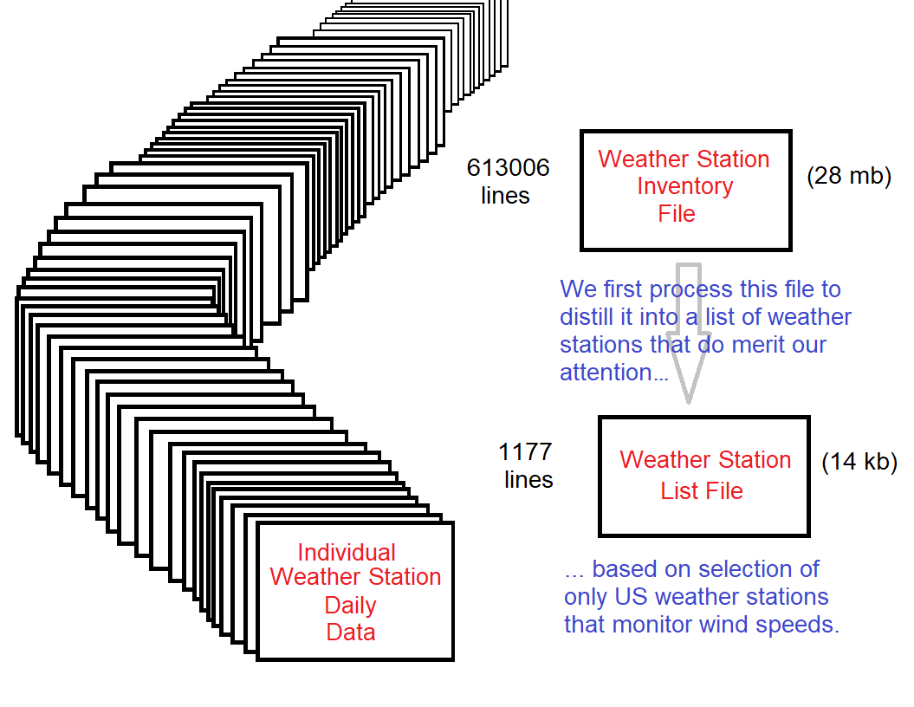
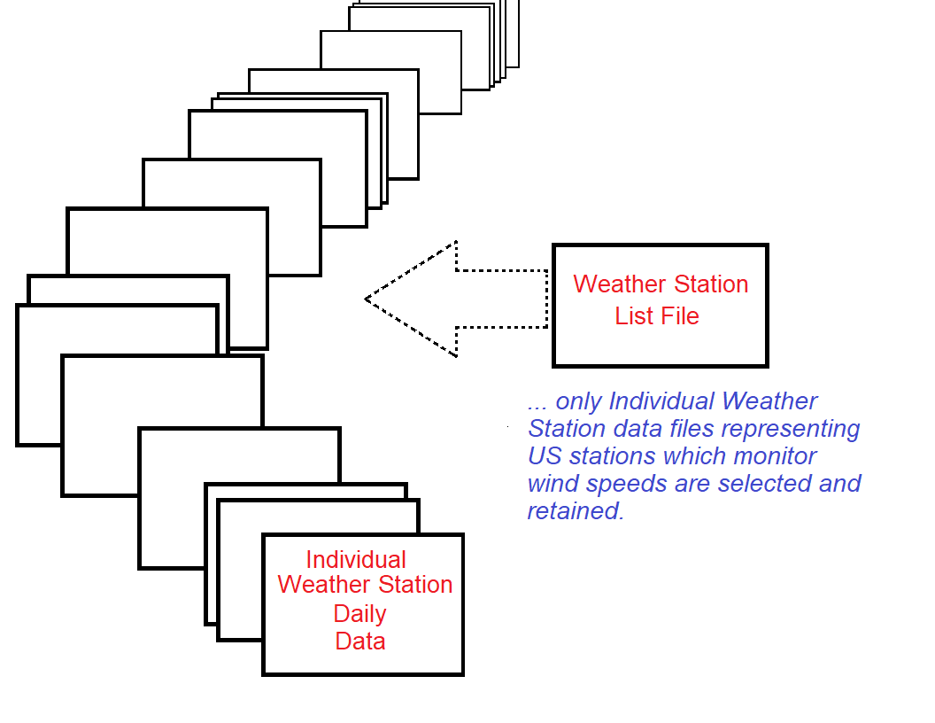
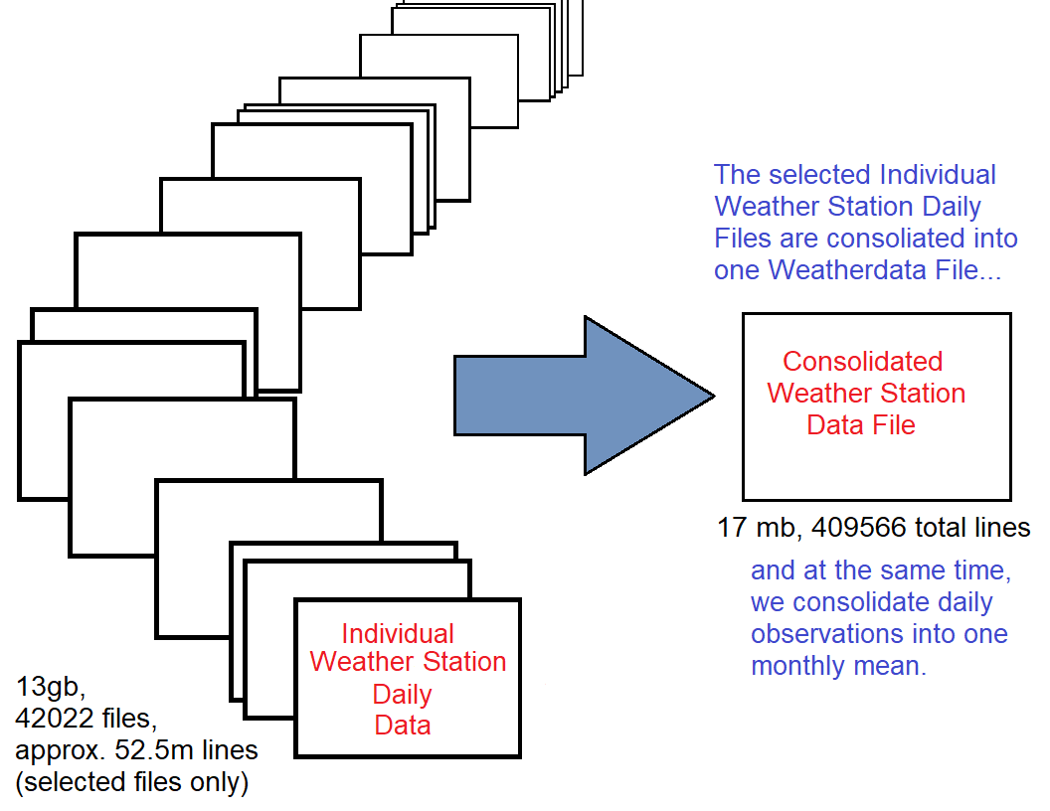
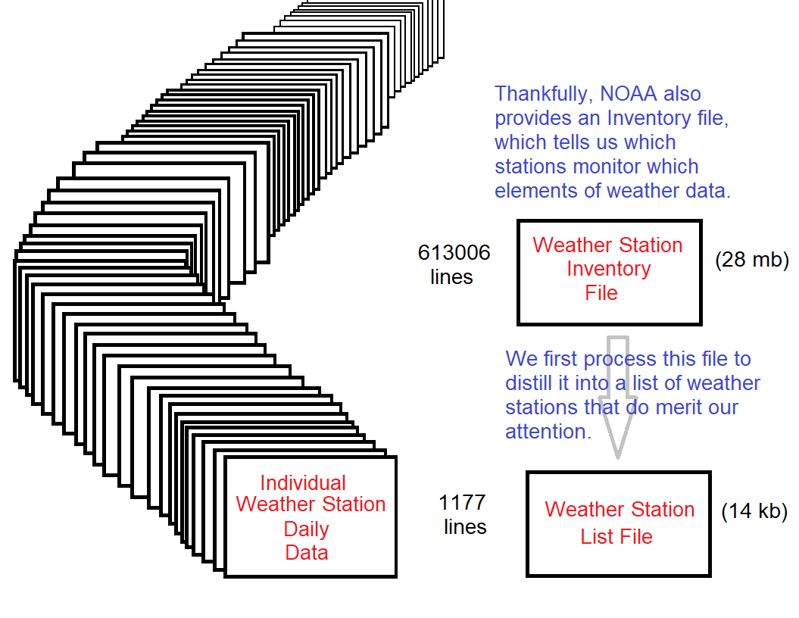
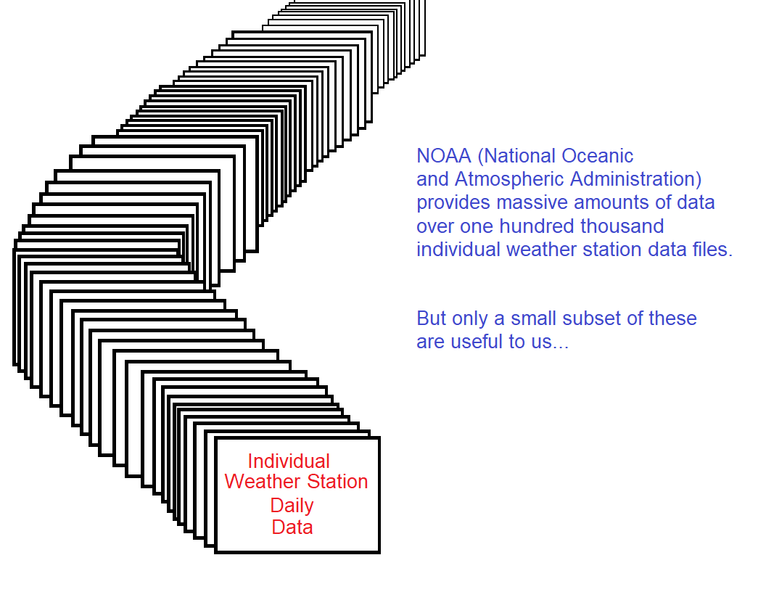
Data gathering and cleaning

Slide 5
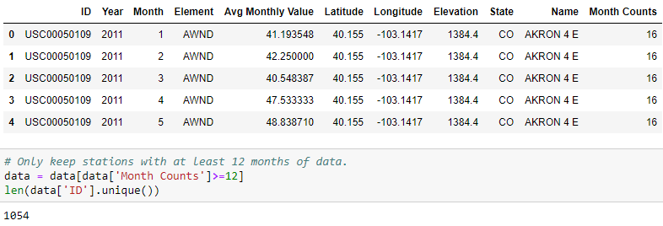
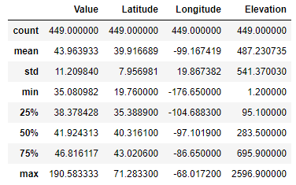
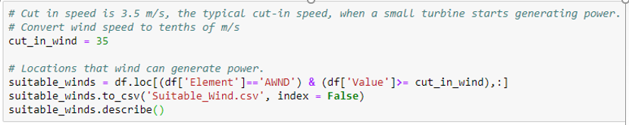
Requirements for wind farms.
8 kph (2 m/s) minimum is required to start rotating most small wind turbines.
12.6 kph (3.5 m/s) is the typical cut-in speed, when a small turbine starts generating power.
36–54 kph (10–15 m/s) produces maximum generation power.

Slide 6
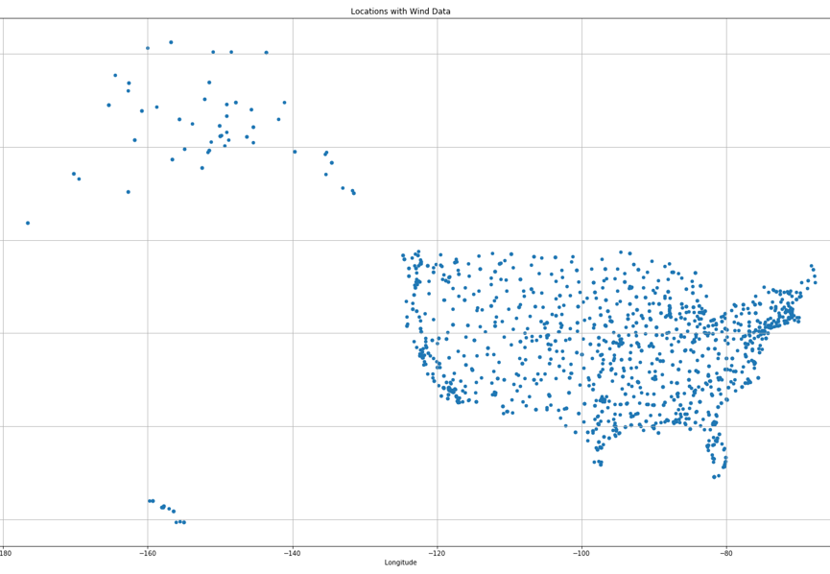
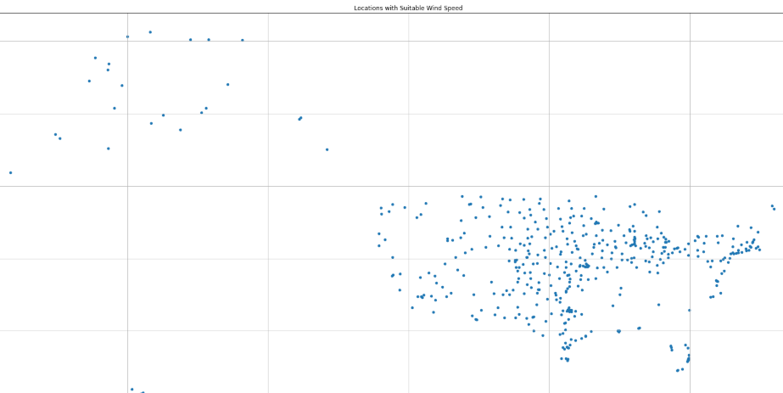
U.s. locations with wind data
U.s. locations suitable wind speed

Slide 7
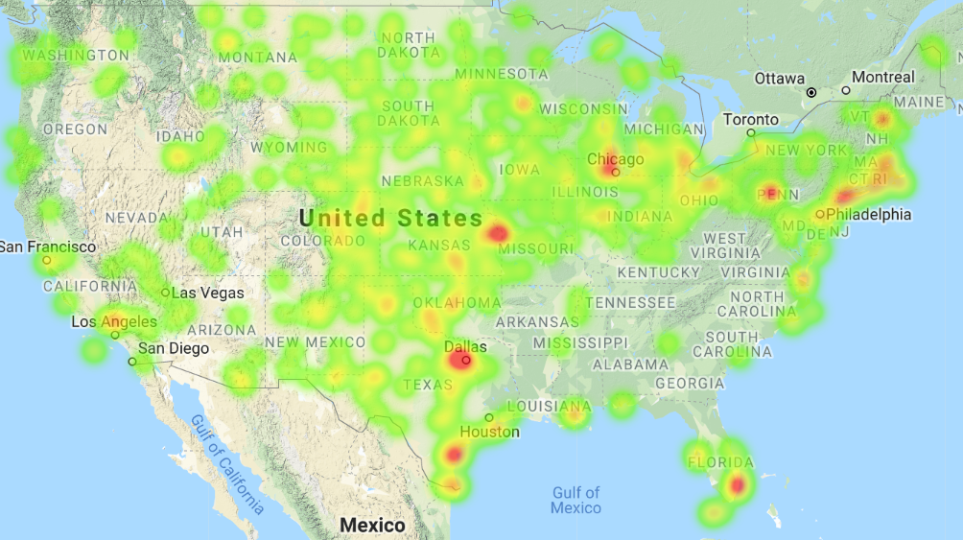
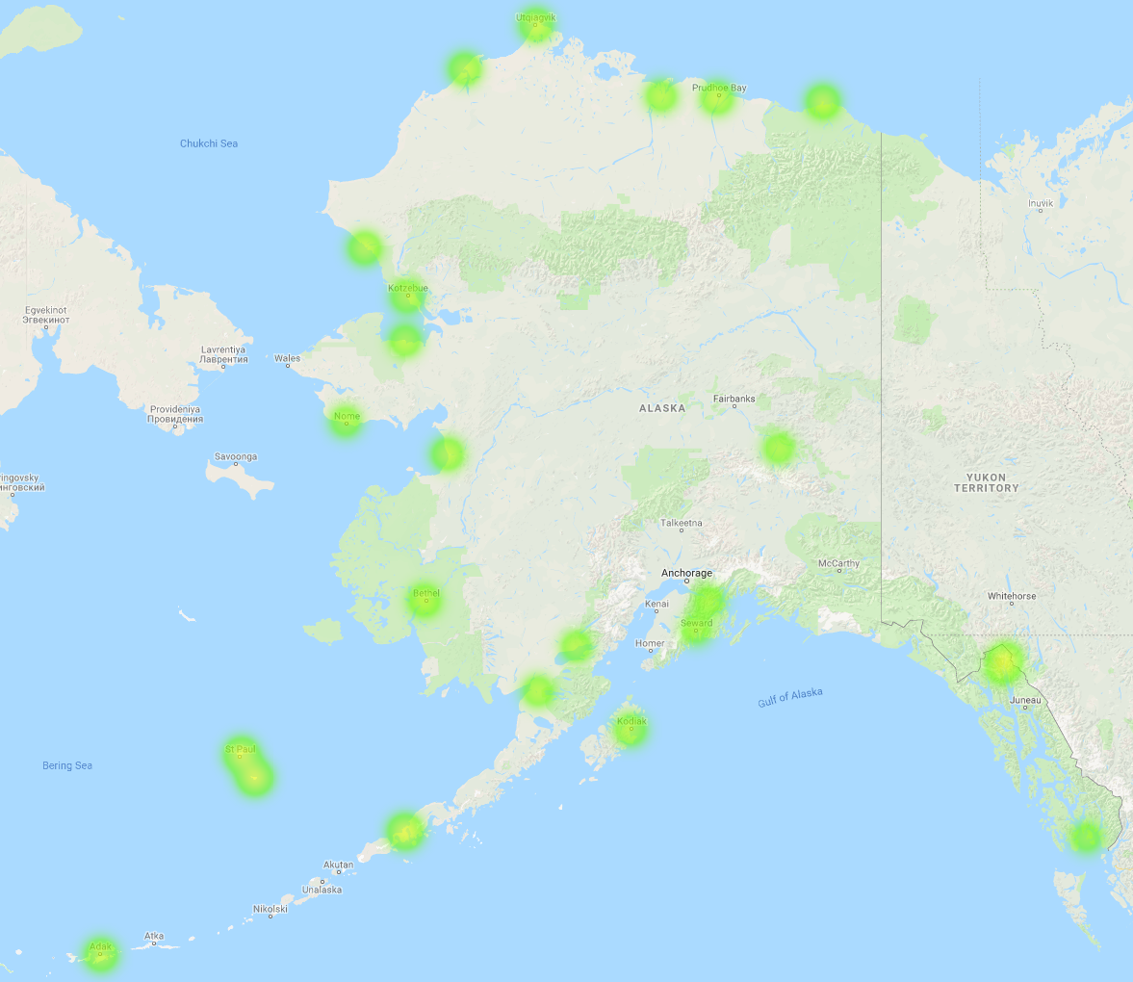
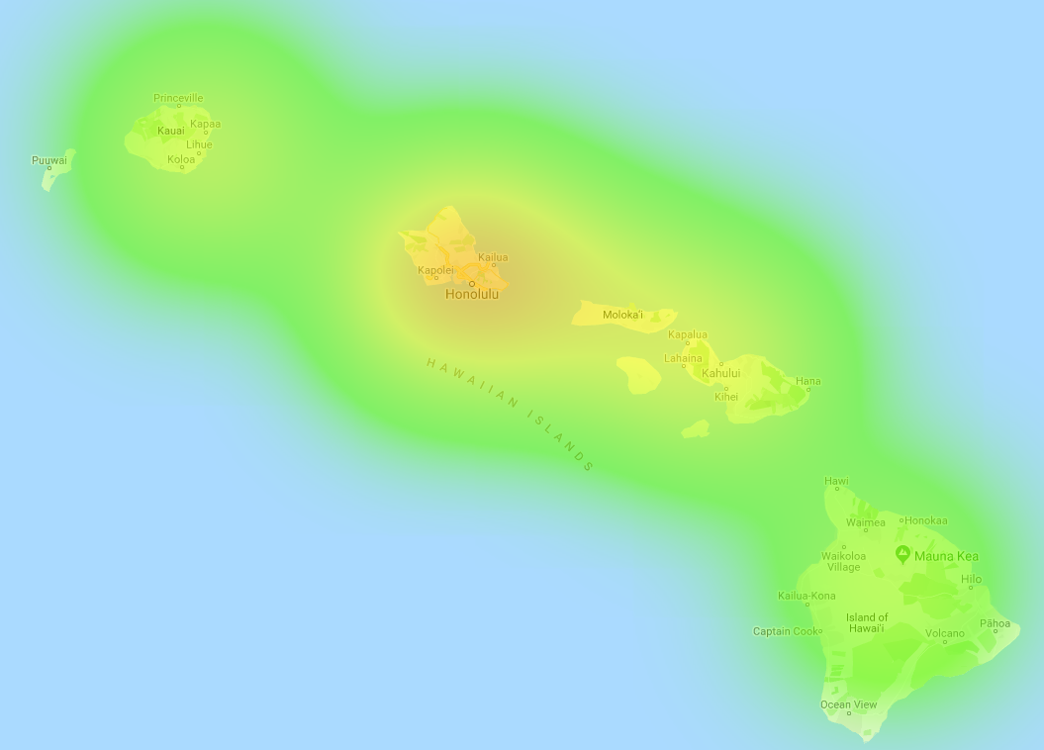
Suitable locations for wind farms?

Slide 8
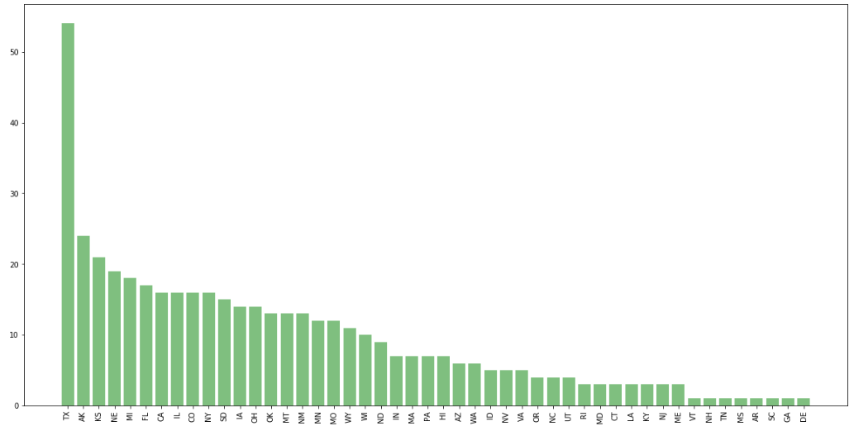
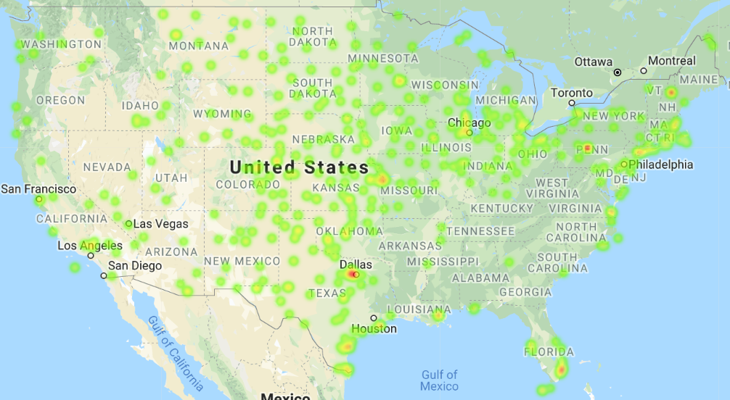
List of States with suitable wind speed

